Slide 1
The Guardian Ranking 2013-2015
Prepared by: Dmitry Volevach

Slide 2
Technologies and Instruments
Visualization:
Power BI
Seaborn
Matplotlib
Data Processing
Pandas
Numpy
Machine Learning
Sklearn

Slide 3
The Guardian Ranking
123 universities
Columns:
Ranking (current, previous, change)
Guardian Score (from 0 to 100)
NSS Teaching, Overall, Feedback (from 0 to 100 in %)
Gathers students’ opinions on the quality of teachers, their courses and feedback
Expenditure per student
The average general government expenditure per student in the given level of education
Student:Staff ratio
The number of students who attend a university divided by the number of teachers in the institution
Career prospects (from 0 to 100 in %)
Value added score (from 0 to 10)
Measures a teacher's effect on his students' achievement
Entry Tariff
The average grade was people had to get, in order to get onto that course

Slide 4
The Guardian – Subject Areas
173 universities
Columns:
Subject Area Name
Ranking (Rank, previous Rank, change)
Guardian Score (from 0 to 100)
Satisfied with Teaching (from 0 to 100 in %)
Satisfied overall with course (from 0 to 100 in %)
Expenditure per student (from 0 to 10)
Student:Staff ratio
Value added score (from 0 to 10)
Average entry tariff
Satisfied with assessment (from 0 to 100 in %)

Slide 5
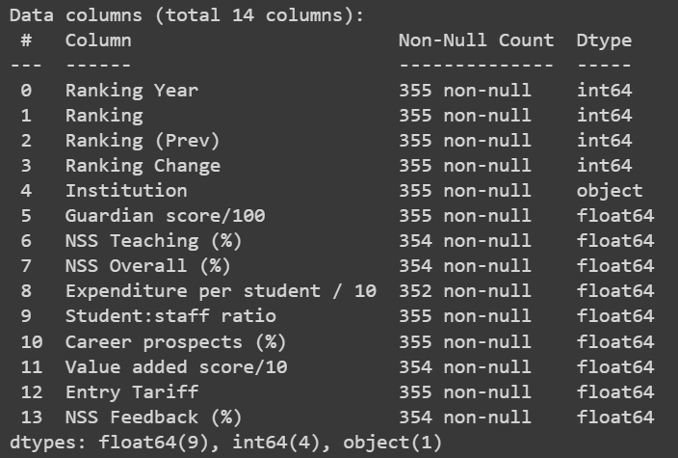
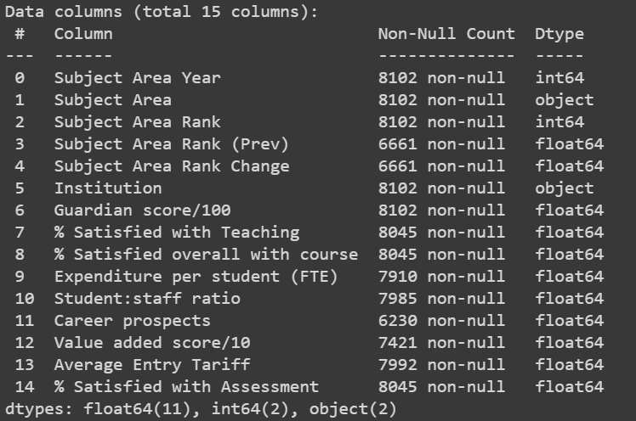
Data Information
The Guardian Ranking
The Guardian – Subject Areas

Slide 6
Data preprocessing
Changed columns type:
Category (“Ranking Year”, “Subject Area Year”, “Subject Area”)
correct distribution of types helps to work more efficiently with the DataFrame
Creating auxiliary DataFrames
2 DataFrames with dropped NaN values
2 Normalized DataFrames
It will be used in machine learning

Slide 7
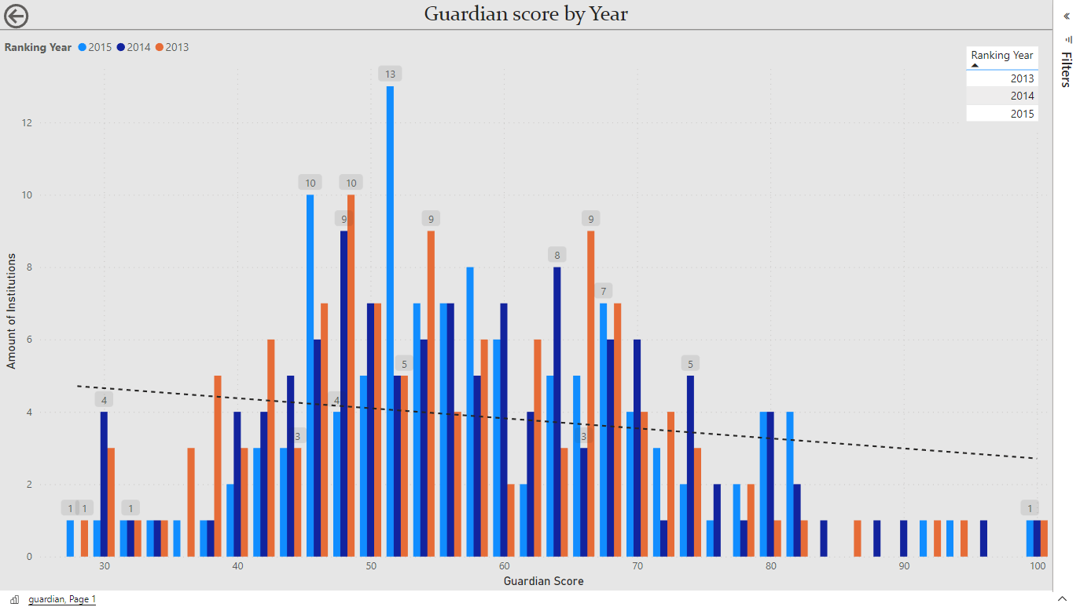

Slide 8

Top 200 QS World University Rankings
2013: 29 universities
2014: 29 universities
2015: 29 universities

Slide 9
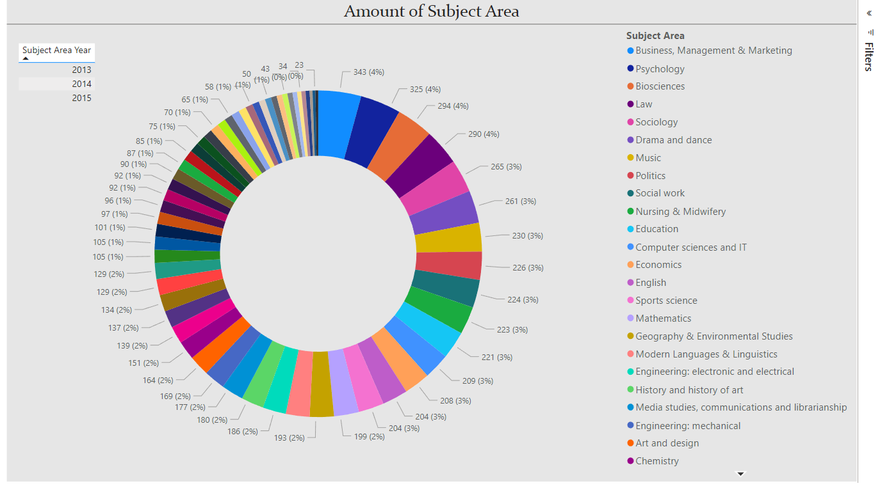

Slide 10
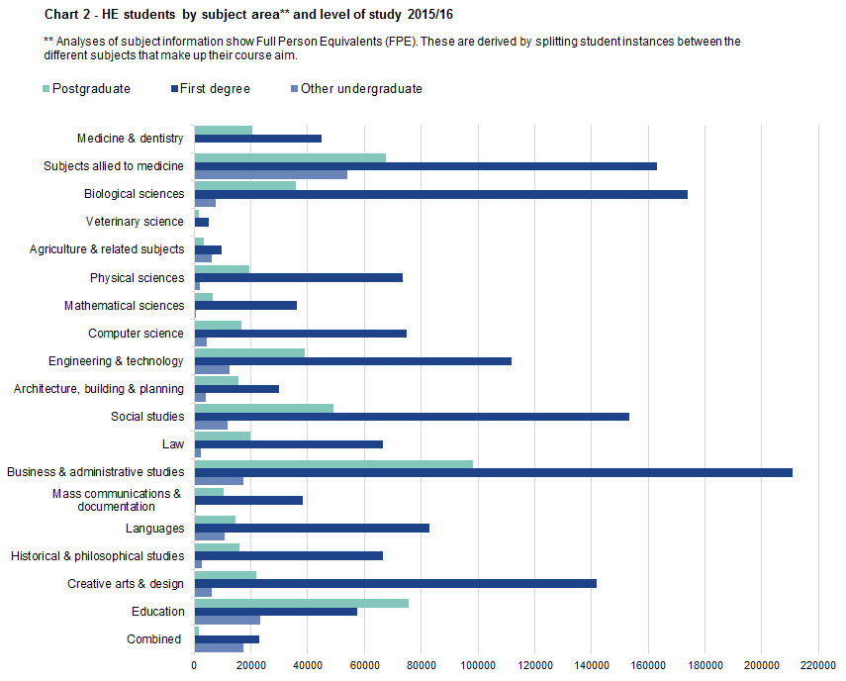
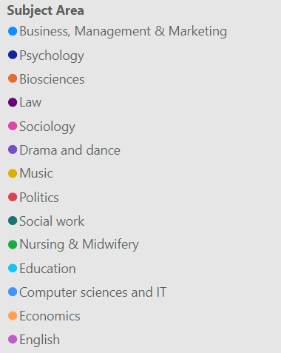
Subject Areas
Source

Slide 11
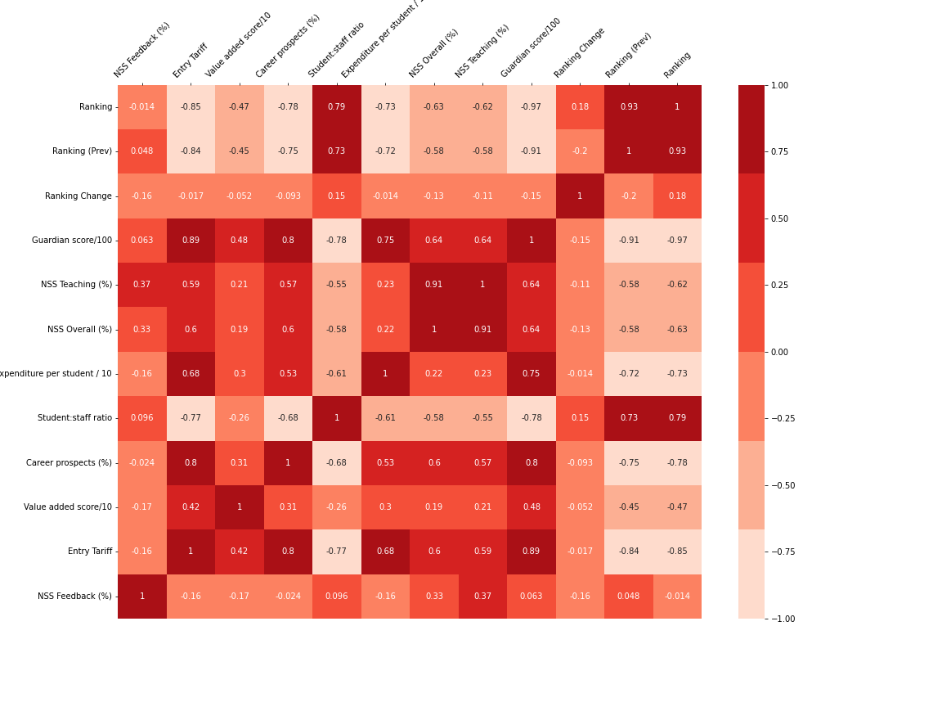
Common Ranking

Slide 12
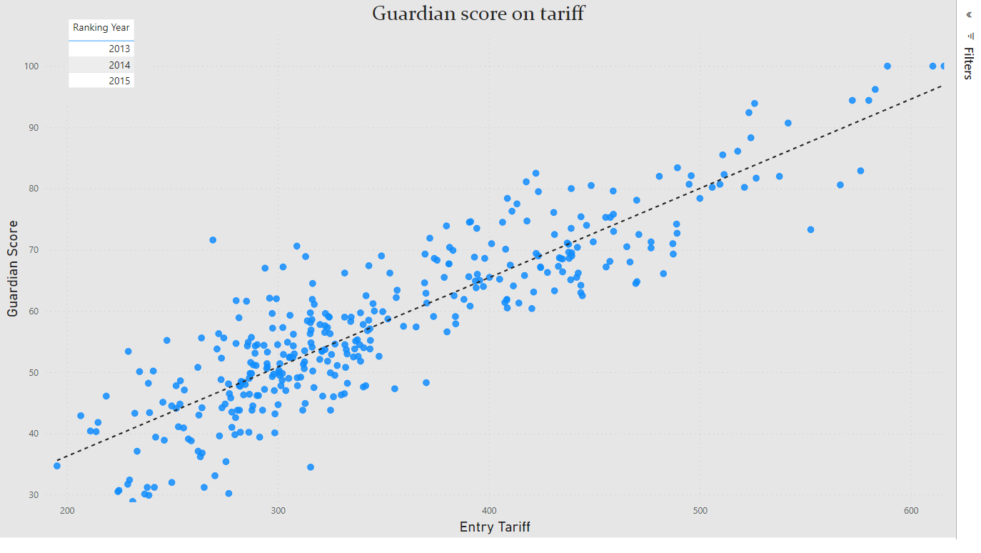

Slide 13
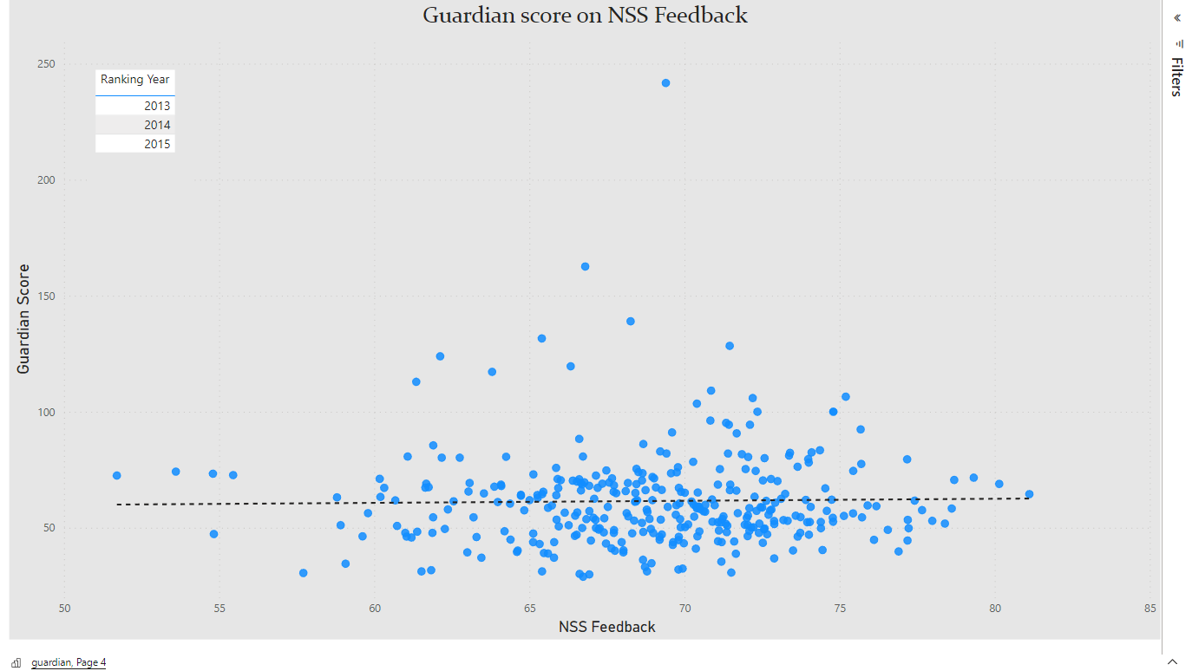

Slide 14
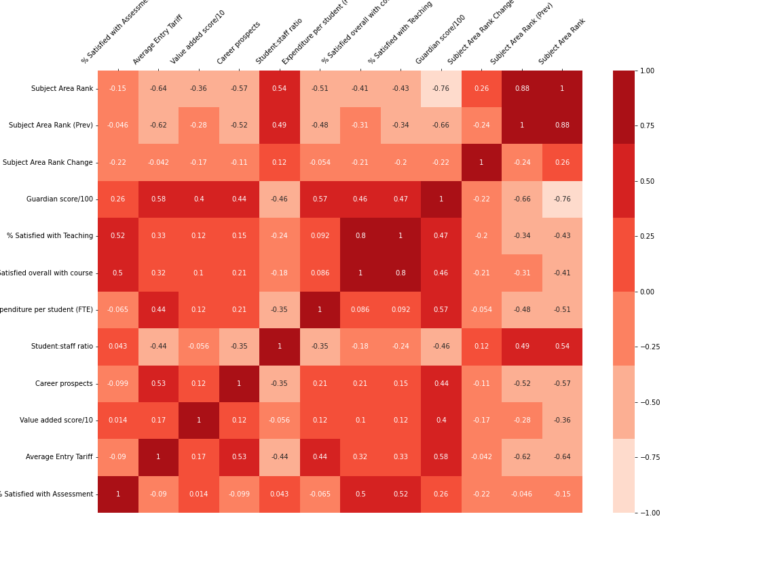
Subject Ranking

Slide 15
Machine Learning
Predict Guardian Score
Linear Regression
linear approach for modelling the relationship between a scalar response and one or more explanatory variables
Features
Satisfied with Teaching
Satisfied overall with course
Expenditure per student
Student-staff ration
Career prospects
Value added score
Average Entry Tariff
Satisfied with Assessment

Slide 16
Linear Regression model
Trained on data 2013, 2014 years
Tested on data 2015 year
Mean Absolute error: 3.97

Slide 17


Queen Margaret
Edinburgh, Scotland
Top-3 universities in Edinburgh
Queen Margaret has the widest range of health degrees in Scotland, ranging from health psychology to audiology and diabetics
Widely recognized expertise in health & rehabilitation, sustainable business and creativity & culture

Slide 18
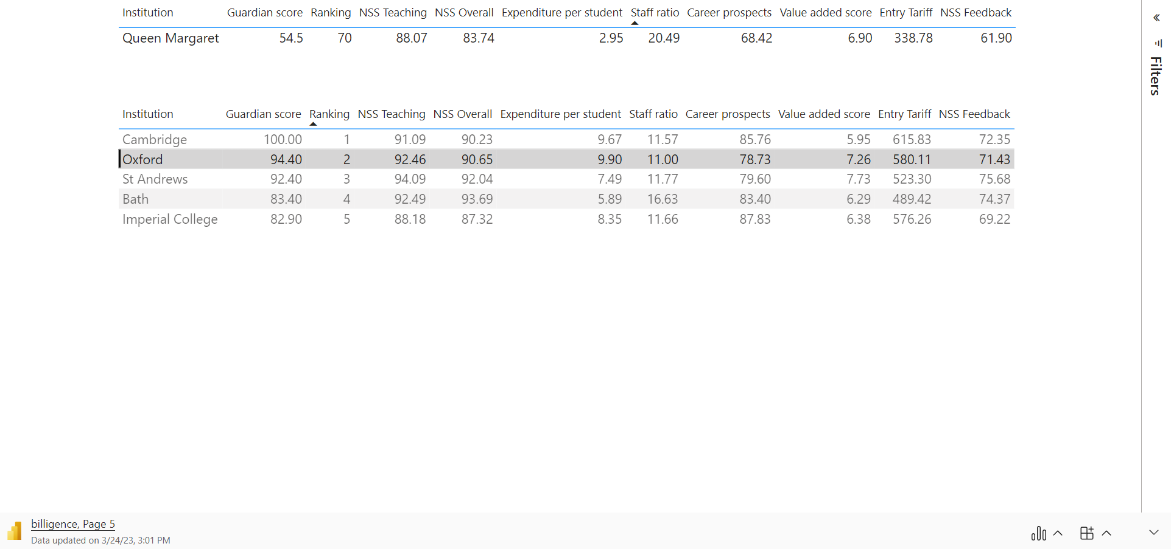
Score prediction
Predicted value for Queen Margaret: 51.54 (real 54.5)
Comparation of separate assessments

Slide 19
Influential parameters
Parameters + correlation coefficient
Career Prospects (0.8)
Student-staff ratio(-0.78)
NSS Overall (0.64)
NSS Teaching(0.64)
Satisfied overall with course(0.57)
Entry Tariff (0.89)
Expenditure per student (0.75)
Average Entry Tariff(0.58)

Slide 20
Career prospects
Opportunity to practice
every employer values a candidate for his experience and acquired skills
through practice, students can understand whether they like this area or not. Also, through practice, they can identify weaknesses
Lections about
employment
time management
presentation skills

Slide 21
NSS Teaching + Overall
Old aged teachers could be a problem
Older teachers may potentially impact the NSS Teaching score due to their potential lack of familiarity with current teaching methods, technology, or best practices in their field, which could result in a less engaging or effective learning experience for students.
Make common meetings with teachers
Common meetings between students and teachers are important because they facilitate communication and improve relationships between them. Also, teachers can share their experience, which will improve the perception of the teacher by the student.
Follow modern techniques of studying
It can improve learning outcomes, efficiency, and retention, and prepare students with relevant skills and knowledge for the modern workforce.

Slide 22
Student:staff ratio
Increase the number of teachers
It will entail an increase in EPS.
Reduce the number of students
This can be done by increasing the Entry Tariff

Slide 23
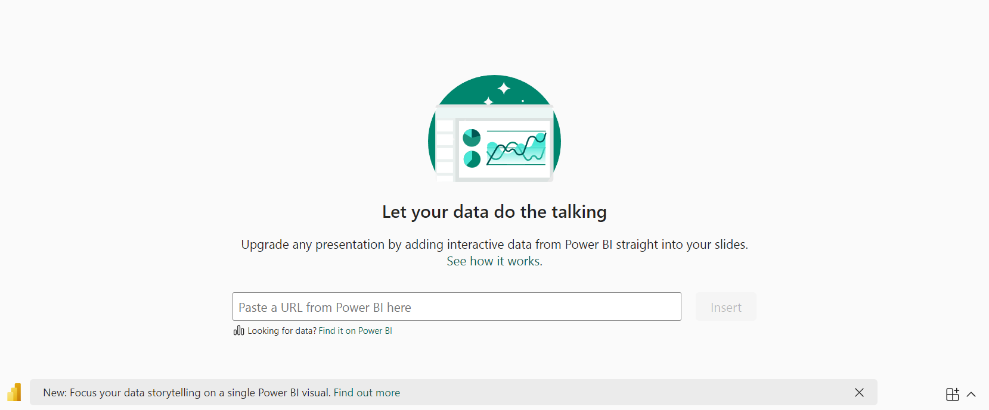
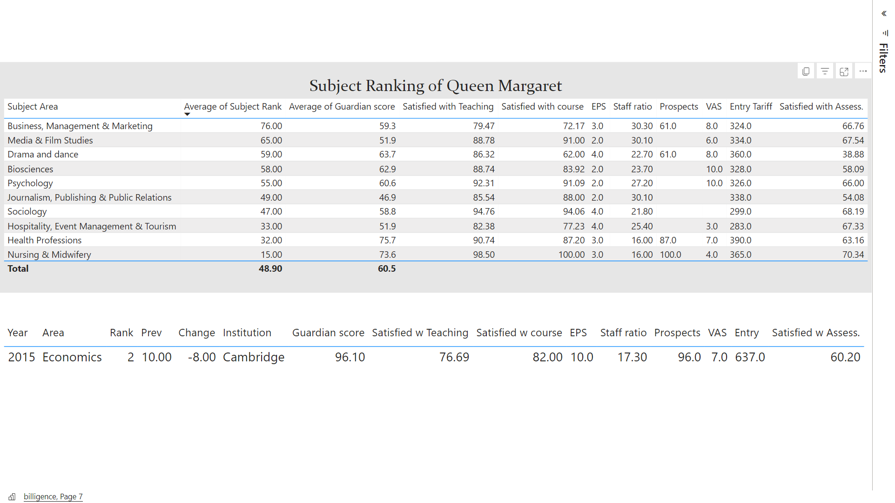

Slide 24
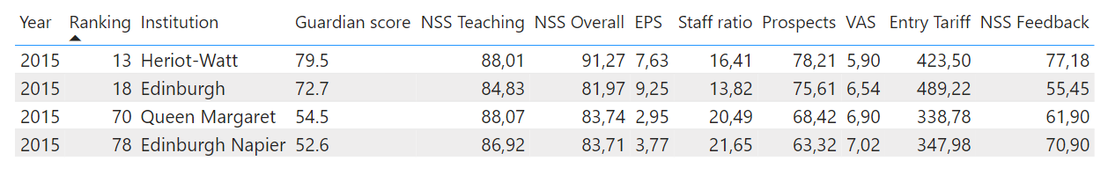
Edinburgh Universities

Slide 25
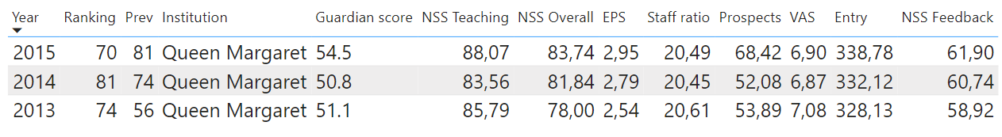
Queen Margaret Ranking 2013-2015
We can improve our assessments: +1% +2% +1 -3 +6% +20

Slide 26
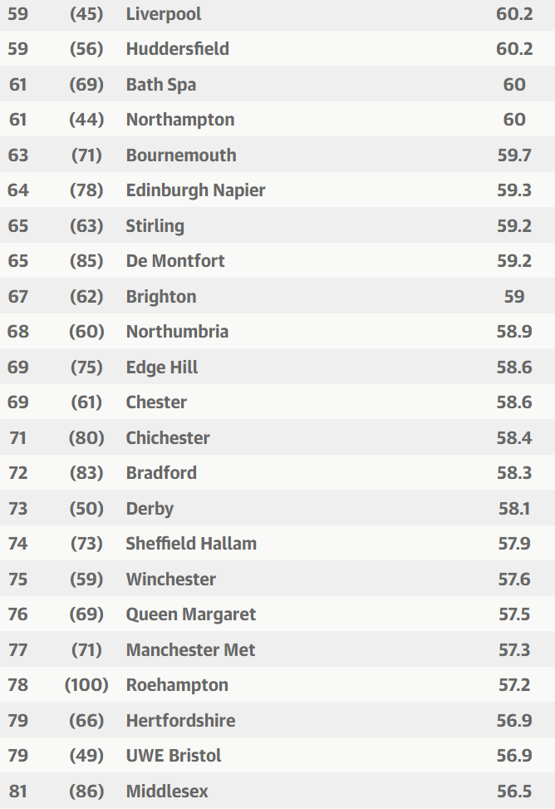
Predictions with improves
Predicted score: 58.75 (+7.8%)
Source: The Guardian Ranking 2016

